Slide 1

Introduction
Business Problem Description.
I have been hired by FIFA (International Federation of Association Football) to decide the city with the best conditions (accommodation, venue, transportation) to host for the World Cup semi-finals and final in Summer 2019. The 2 cities running to host the event are New York in USA and Toronto in Canada.

Slide 2
Data
The data used is coming from the following sources:
New York City Data (CSV file).
Toronto Data (Wikipedia).
Toronto Coordinates (CSV file)
Foursquare.com
FIFA (Web Page)

Slide 3
Methodology
Cleaning the Data
In the first place I had to obtain and clean the information for both cities. The information is coming in different formats:
For Toronto the information was coming from a table located in the following web page: https://en.wikipedia.org/wiki/List_of_postal_codes_of_Canada:_M
Second Step on this process was to open and clean up New York’s data.
This was a very simple step, because I had a CSV file available with the data. So to get it I just applied:
pd.read_csv(r’File_Location\NewYork_Data.csv’)
Exploring the Data:
I start exploring data using Foursquare data.
Creating Clusters
After exploring the data and obtaining al venues, I proceed to create cluster for both cities.
Evaluation and comparison of each Cluster/City:
I use the cluster results to evaluate all cluster in each city and weight them.

Slide 4
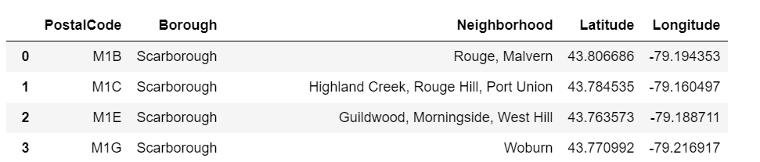
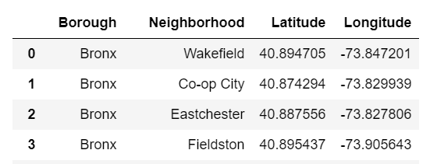
Results
Cleaning the Data:
I obtained at the end of this process 2 tables with all Neighborhood and coordinates for each city.:
Toronto:
New York:

Slide 5
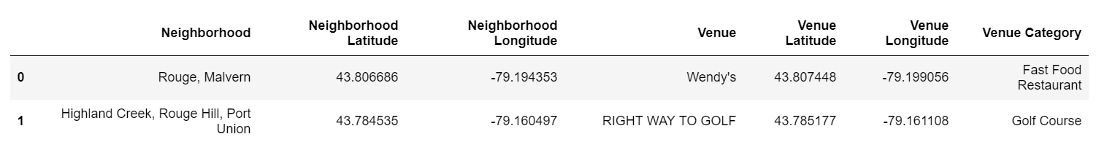
Results
Exploring the Data:
The results obtained after this process is one table for each city where we are able to see the Neighborhoods and Venues together in the same table alone with their coordinates .
Toronto:
New York:

Slide 6
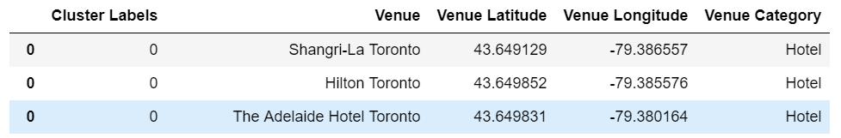
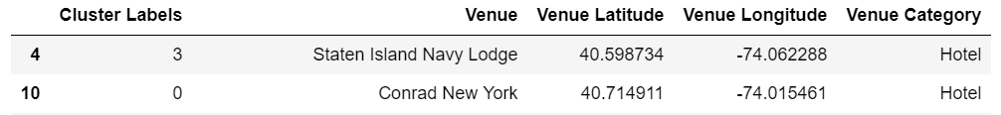
Results
Creating Clusters:
The idea is to assign clusters according to every venue in the city according to the segmentation used to do the qualification. Hence: Food & Beverage, Accommodation, Transportation, Stadiums. Results obtained:
Toronto:
New York:

Slide 7

Results
Evaluation and Comparison:
I did the comparison between Categories:
Example of one of them:
The winner City will be one with more cumulative points overall:

Slide 8
Conclusion
The winner of the contest is:
NEW YORK CITY
We can conclude that since I was evaluating only infrastructure the result reflects the wider infrastructure present in New York than in Toronto.
As mention in the Discussion section, this may change incorporating more relevant data.

